Slide 1
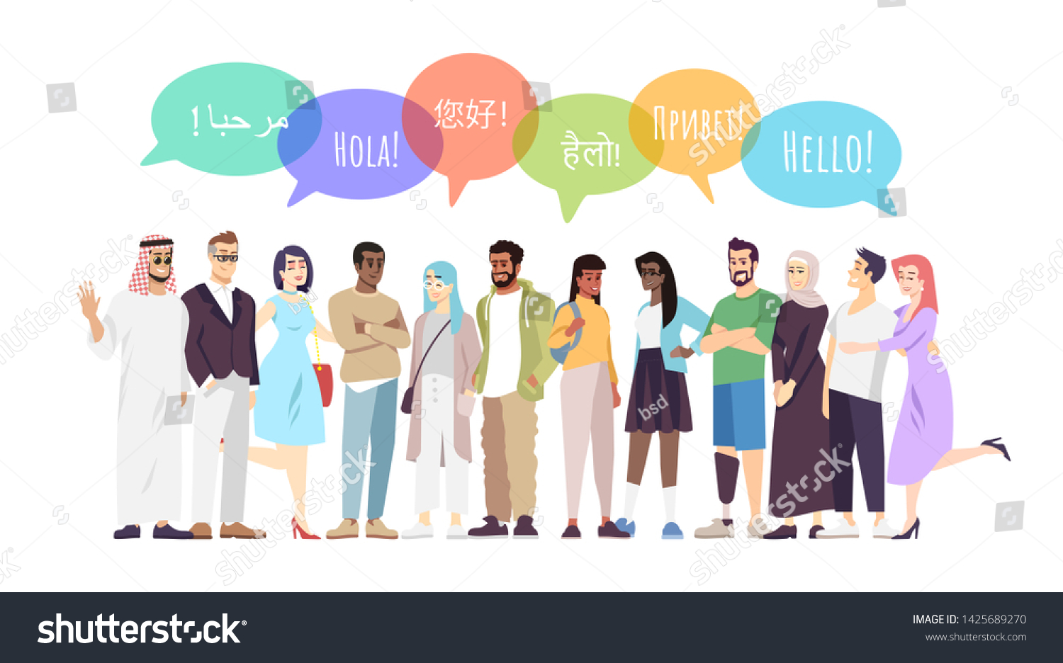
What is culture?
Language and culture

Slide 2


What is culture?
What is intercultural communication
Language and culture

Slide 3
Culture
For Williams, culture ‘is one of the three most complicated words in the English language’(1984: 87).
Williams adds that this complexity results from the term’s ‘intricate historical development in different languages’ (p. 87) and its multiple ‘variations of use’ (p. 92). Building on Williams, Eagleton claims that ‘culture is a multifaceted concept, which makes it hard to run a tightly unified case about it’ (2016: viii). In similar terms, for Hall ‘culture is one of the most difficult concepts in the human and social sciences’ with ‘many different ways of defining it’ (1997a:
Following Clifford’s comment that ‘cultures do not hold still for their portraits’ (1986: 10), the same can be said of the manifold scholarly perspectives informing culture-related research. Thus, any attempt to capture the dynamics of the notions of culture in circulation – both in everyday discourse and in scholarly debates – can only be selective and subject to limitations.

Slide 4
Meanings of ‘Culture’: From the Roman colere to the Linguistic Turn
Employing a historical perspective, scholars such as Ort (2003: 19), Posner (2003: 39) and Williams (1984: 87) refer to the Latin verb colere as the linguistic and conceptual basis for the modern term ‘culture’. The meanings of colere are fourfold: (1) the tending of natural growth (husbandry, agriculture); (2) habitation in an area or place (the term ‘colony’ is a
derivative of this meaning); (3) religious worship (cultus deorum); and (4) the spiritual, artistic and intellectual education of people (as in Cicero’s cultura animi or the Greek concept of paideia) (Ort, 2003: 19; Williams, 1984:87).
In the Middle Ages only two of these meanings remain active, namely culture as husbandry (cultura agri) and culture as religious worship (cultus). In the Renaissance a new meaning becomes important, which links back to the Latin cultura animi and the Greek paideia’, yet now with a secular emphasis.

Slide 5
In Williams’ words, culture is defined as ‘the signifying system through which . . . A social order is communicated, experienced and reproduced’ (1983: 12). In other words, culture, here, stands for the language used by humans to give meaning to their lives. According to Ort (2003: 24) and Posner (2003: 39), such a perspective has its founding father in the German philosopher Ernst
Cassirer (1998 [1923–29]), who defined culture as the sum total of a society’s signifying practices. According to Bachmann-Medick (2016: 21–2), another key influence is linguistic philosophy as advocated by Rorty (1967) with its tenet that there is no reality independent of language.
Since around 1970 ‘culture’ has become a widely used term in manifold contexts. In politics, it has served the far right to hide their racism behind insistence on preserving a culture in the face of unbridgeable cultural differences, while disadvantaged groups such as women or gay people have invoked it to fight for their identity-related aims.

Slide 6
Moreover, culture is placed in opposition to nature, whose roughness, savagery and unpredictability need to be tempered and improved upon by human intervention through education and through control over the natural environment (Ort, 2003: 19).
With the advent of Romanticism, the term culture takes on a new meaning. As a reaction to the excesses of industrialization, the idea of culture is now linked to the wish to go back to a pre-industrial state in which human life was not corrupted by ‘soulless and impoverished’ industrial civilization (Eagleton, 2016: 10).
Thus, culture and civilization, which in their meanings have previously been used interchangeably, now become opposite terms, with culture being the privileged concept (e.g. Ort, 2003: 21,24).
A key thinker here is the German philosopher Johann Gottfried Herder, who breaks with earlier concepts in various ways. First, he is critical of European colonialism and its claim to cultural superiority (Eagleton, 2016:77–8, 83; Herder, 1989 [1784–91]: 706). Rather than seeing cultural development as a universal and unilinear process, he speaks of a plurality of cultures, each having the right to exist with its own specific features (Herder, 1989: 298–304). Secondly, these different cultures are constituted by the Romantic concept of an ‘informing spirit’ (Williams, 1983: 11), which Herder conceives as being the result of a long tradition passed on over many generations (Herder, 1989: 294–335). Thirdly, in the light of the corrupting presence of civilization, Herder suggests a return to an unadulterated folk culture which helps to promote the health and longevity of a nation (Herder, 1989: 573). Fourthly, in current debates Herder is mainly criticized for viewing cultures as homogeneous, closed entities with distinctive world views (Eagleton, 2016: 83; Welsch, 2017: 10–11).

Slide 7
Following Herder’s definition, culture now designates a particular way of life, and, with the rise of nationalism, the term becomes a synonym for national culture. Culture as a way of life is also the concept used by early anthropology. Unlike Herder’s thinking, early anthropology is shaped bythe belief in the superiority of European culture(s), as can be seen in the theories of social evolution suggested by Tylor (1903 [1871]) and Morgan (2013 [1851]). Eagleton, therefore, speaks of ‘the unholy alliance between colonial power and 19th century anthropology’ (2016: 131), and Piller adds that this belief in European cultural superiority ‘provided the moral justification for colonialism’ (2011: 21).
In contrast to Arnold and Whitman, Karl Marx regards culture as a phenomenon of secondary importance.
For Marx (1867), culture is a superstructure dependent on a society’s economic base, which, depending on the specific constitution of that society, makes certain realizations of culture possible.

Slide 8
Which Comes First, Culture or Non-Culture?
For some proponents of the cultural turns, language and its social function lie at the heart of human existence. An earlier example is Foucault’s(1970) argument that certain discursive formations provide the basis for what can be said, thought, felt and done in specific socio-historical contexts, with the will to power being the key motivator for discoursecreation.
Four decades later, an alternative explanation is offered by the historian Harari (2011: 181) in his bestselling book Sapiens: A Brief History of
Humankind.
Harari (2011: 181) stresses the importance of powerful myths and fictions as the glue that holds people together. For him, the notions of religion, empire and money have proven to be the most effective forces in the history of humankind for creating imagined communities, with trust in money being the myth on which a neoliberal socio-economic order is based (Harari,
What Is Culture? 25
https://doi.org/10.1017/9781108555067.003 Published online by Cambridge University Press
2011: 234).

Slide 9
Culture and Communication in a Globalized
Modernity
When culture is viewed as a signifying system, culture and communication are inextricably linked. In other words, culture is created, stabilized, contested and challenged through communication with the aid of various sign systems. In the light of Harari’s notion of myths, such communication can go beyond borders and aim for potentially worldwide impact. Indeed, the need for intercultural communication is a result of expansionist programmes (Piller, 2011: 19). In a globalized modernity, this need has increased tremendously because of economic, ecological, demographic, technological, political or ethical issues of global significance. new possibilities and increased communication to disproportionate levels
when compared to earlier times.
For Bauman (2000), human society in the twenty-first century lives in a ‘liquid modernity’ characterized by permanent and rapid change and the
continual need to create new knowledge to cope with changing demands.

Slide 10
The economic engine behind such modernity is neoliberalism with its consumerist and expansionist agenda. Politically and ethically, this programme has connections with concepts of postmodernism, in which old certainties are thrown overboard. As a result, state control or pre-given moral precepts have lost importance, and the onus has shifted to individual humans to take responsibility for their own lives. Indeed, because of this new global interconnectedness the personal is also implicated in widereaching dimensions.
Indeed, the prominent role of communication in a globalized modernity is repeatedly emphasized in culture-related debates. From a cosmopolitan perspective, Sobré-Denton and Bardhan stress that ‘cosmopolitanism is inherently communicative’ (2014: 31). In a similar vein, Delanty points out that in a ‘postmodern world’ communication has become more important because of the ‘loss of markers of certainty’ (2009: 219). Delanty adds that ‘intercultural communication is now more important than ever’ and makes a case for connecting such communication with political action to further democratic aims and objectives (p. 219).

Slide 11
In intercultural, transcultural and cosmopolitan studies, links have been forged between power-critical perspectives and communicative competence.
For example, Piller states that ‘it is not the role of intercultural communication scholarship to be complicit in hegemonic cultural politics,but to help us understand how these work’ (2011: 53). Kraidy argues infavour of a transcultural perspective which gives insight into ‘the seductive discourse and reductive structure of globalization’ (2005: 161), while Sobré-Denton and Bardhan advocate a cosmopolitanism which is critical of colonial violence and European (and later also US) hegemony (2014: 2).\
For all these scholars, communicative competence includes ideology-critical abilities, and they all subscribe to a notion of culture which stresses the dynamism, diversity, interconnectedness and permeability of human life approaches in the twenty-first century. Thus, a critical perspective on culture and communication is indispensable to an understanding of the hegemonic interests underlying certain programmes and practices. There is a danger, however, that such criticism is only applied to neoliberal programmes and practices of Western (neo)colonialism, while anti-Western perspectives are not considered. In the light of new anti-Western fundamentalisms, such perspectives also merit attention to better understand the discursive strategies employed and the complex histories from which they are derived (e.g. Buruma & Margalit, 2004).

Slide 12
hegemonic interests underlying certain programmes and practices. There is a danger, however, that such criticism is only applied to neoliberal programmes and practices of Western (neo)colonialism, while anti-Western perspectives are not considered. In the light of new anti-Western fundamentalisms,such perspectives also merit attention to better understand the discursive strategies employed and the complex histories from which they are derived (e.g. Buruma & Margalit, 2004). For intercultural communication research, a critical perspective is also needed to pinpoint the limitations of the many travel guides cum advice
books in circulation, which are often nationalist and highly stereotypical in
approach. Such criticism also applies to intercultural management publications
and seminars building on nation-bound concepts such as those suggested
by Hofstede (1994) or Lewis (2006).

Slide 13
Finally, a critical perspective must also include acknowledgement of non-cultural factors, which are swept under the carpet, when, for example, culture is invoked as the key differentiator between people by right-wing political groups. In this context, Piller refers to the ‘frequent misrecognition of material and social inequality as cultural difference’, with the purpose of excluding ‘outsiders’from certain communities and their resources (2011: 172).
Views cultures as shared and contested sets of signifying practices resulting from human interaction with the complex environments in which people live. Moreover, cultures are treated as multidimensional, open-ended and dynamic entities, for which, as in Bakhtin’s words, ‘there is no first word . . . and the final word has not yet been spoken’ (1981: 30).
The importance for intercultural communication in a globalized modernity is acknowledged, without privileging language as a signifying system over other factors. Finally, I argue for a differentiated understanding of human life-worlds with reference to both the cultural and non-cultural factors co-shaping them. Culture is a highly complex concept with manifold meanings.
However, awareness of some of its uses can foster critical self reflection and a better insight into what other people mean by it.

